Slide 1
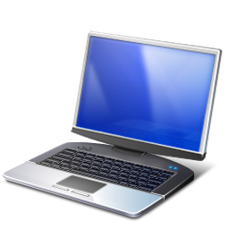
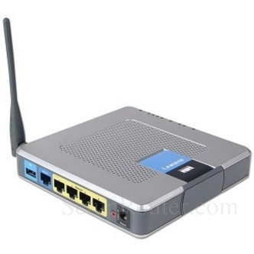
802.1x Network Access
Radius Server

Slide 2

802.1x Network Access
Radius Server
Intel® AMT
MeshCentral

Slide 3

802.1x Network Access
Radius Server
Intel® AMT
MeshCentral

Slide 4
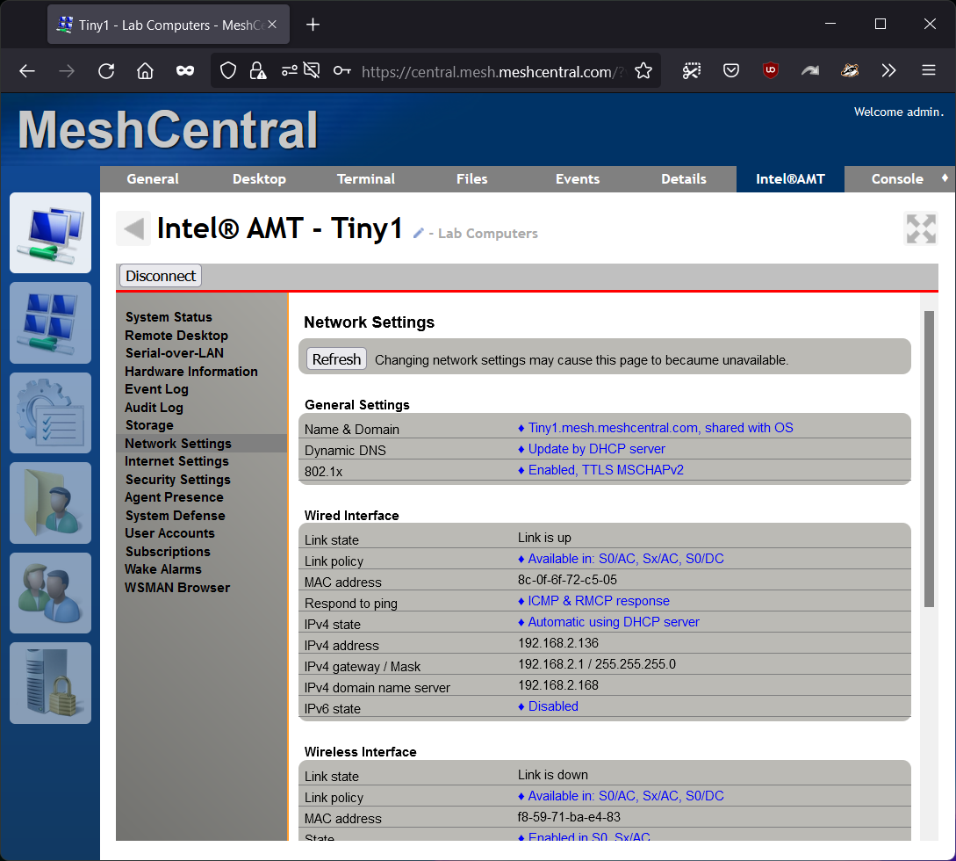
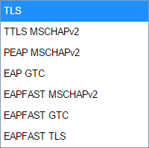
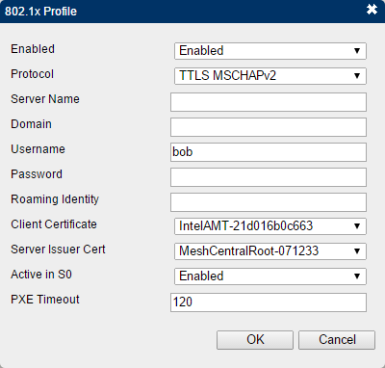

Slide 5
All device will use the same credentials.
Intel® AMT
Intel® AMT
Radius Server
Intel® AMT

Slide 6

MeshCentral
Intel® AMT
{
"domains": {
"": {
"AmtManager": {
"802.1x": {
"AuthenticationProtocol": "PEAPv0/EAP-MSCHAPv2",
"Username": "ylian",
"Password": "mypassword"
},
"WifiProfiles": [
{
"name": "Summit",
"ssid": "Summit",
"authentication": "wpa2-802.1x",
"encryption": "ccmp-aes"
},
{
"ssid": "Summit-G2",
"authentication": "wpa2-psk",
"encryption": "ccmp-aes",
"password": "mypassword"
}
]
}
}
}
Radius Server
Config.json

